Slide 1
Abstractions, processes, resources Influence of security, networking, and multimedia

Slide 2
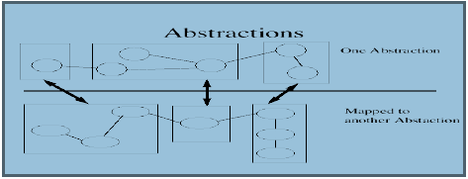
Abstraction
Abstraction, in traditional systems, naturally forms layers representing different levels of complexity.

Slide 3
Types
Abstraction can be accomplished on functions, data, and processes.
In functional abstraction, details of the algorithms to accomplish the function are not visible to the consumer of the function. The consumer of the function needs to only know the correct calling convention and have trust in the accuracy of the functional results.
In data abstraction, details of the data container and the data elements may not be visible to the consumer of the data.
In process abstraction, details of the threads of execution are not visible to the consumer of the process. An example of process abstraction is the concurrency scheduler in a database system

Slide 4
Process
In the Operating System, a Process is something that is currently under execution.
So, an active program can be called a Process.
For example, when you want to search something on web then you start a browser.
This is denoted by process state. It can be ready, waiting, running, etc.

Slide 5
Resource
Operating system (OS), program that manages a computer’s resources, especially the allocation of those resources among other programs.
Typical resources include the central processing unit (CPU), computer memory, file storage, input/output (I/O) devices, and network connections.

Slide 6
Networking
Network Operating System is one of the important types of operating system.
Network Operating System runs on a server and gives the server the capability to manage data, users, groups, security, applications, and other networking functions.
The basic purpose of the network operating system is to allow shared file and printer access among multiple computers in a network, typically a local area network (LAN), a private network or to other networks.
Some examples of network operating systems include Microsoft Windows Server 2003, Microsoft Windows Server 2008, UNIX, Linux, Mac OS X, Novell NetWare, and BSD.

Slide 7
Networking OS
Advantages • Centralized servers are highly stable. • Security is server managed. • Upgradation of new technologies and hardware can be easily integrated into the system. • It is possible to remote access to servers from different locations and types of systems. Disadvantages • High cost of buying and running a server. • Dependency on a central location for most operations. • Regular maintenance and updates are required.

Slide 8
Security
Operating systems security plays a primitive role in protecting memory, files, user authentication and data access protection.
Consistent protection means that the system meets standard security requirements and have the required functionality to enforce security practices
A computer’s operating system must concentrate on delivering a functionally complete and flexible set of security mechanism for security policies to be effectively enforced.

Slide 9
Multimedia
Multimedia Operating Systems are the operating systems that can deal with the multimedia files.
Multimedia files are different from the traditional files
They need special considerations for process management, secondary storage management, file management, and soon.
Multimedia kind of data consists of continuous media in the form of files (audio or video) data as well as conventional files to run.
An operating system whose primary job is serving videos would differ from a traditional operating system in three ways.
• process scheduling • the file system • disk scheduling

Slide 10
Thank you

